Slide 1

“Dashionaire”

Slide 2
First….some “rules”
We unfortunately do not have a million dollars to give out, but every correct question will get candy!
One person per question (and everyone will get a question!)
We will ask for a volunteer for each question BEFORE you read it, you don’t know what you’re gonna get!
There are 2 lifelines, where you can ask another designer in the room, you pick the designer, you cannot ask who knows it

Slide 3
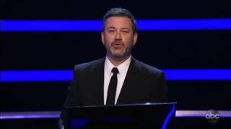

Slide 4


Slide 5
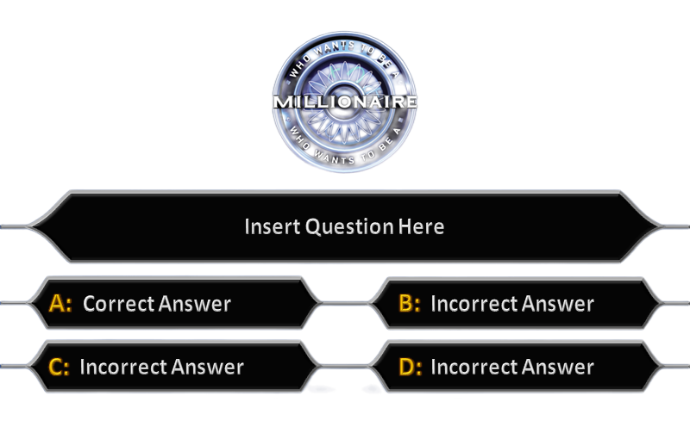
Which of the following is the accurate order of highest to lowest NPS scores for Q2 2025?
Mx, Cx, Dx
Cx, Dx, Mx
Mx, Dx, Cx
Dx, Mx, Cx

Slide 6
Which of the following is the accurate order of highest to lowest NPS scores for Q2 2025?
Mx, Cx, Dx
Cx, Dx, Mx
Mx, Dx, Cx
Dx, Mx, Cx
Source

Slide 7
What amount do Cx most frequently quote as a “low value deal” that is not worth a purchase? ?
Under $3
Under $5
Under $10
Under $20

Slide 8
What amount do Cx most frequently quote as a “low value deal” that is not worth a purchase? ?
Under $3
Under $5
Under $10
Under $20
Source

Slide 9
About how many active CPG-only Ads Manager brands do we currently have?
140
500
240
800

Slide 10
About how many active CPG-only Ads Manger brands do we currently have?
140
500
240
800
Source

Slide 11
About how many active Rx-only Ads Manager users do we currently have?
140
500
240
800

Slide 12
About how many active Rx-only Ads Manager users do we currently have?
140
500
240
800
Source

Slide 13
Which CPG brand currently spends the most on DoorDash marketing?
Coca-Cola - Mediacom
Unilever - All
P&G - All
Pepsi + Frito Lay

Slide 14
Which CPG brand currently spends the most on DoorDash marketing?
Coca-Cola - Mediacom
Unilever - All
P&G - All
Pepsi + Frito Lay
Source

Slide 15
What percent of Cx DO NOT have a cuisine in mind when opening the DoorDash app?
5%
16%
21%
34%

Slide 16
What percent of Cx DO NOT have a cuisine in mind when opening the DoorDash app?
5%
16%
21%
34%
Source

Slide 17
How many promotion types do we offer Mx?
Three
Six
Ten
Twelve

Slide 18
How many promotion types do we offer Mx?
Three
Six
Ten
Twelve
Source

Slide 19
What did Cx who abandoned the DoorDash app indicate as the top reason why they were visiting the app in the first place?
To check out deals/promos
To look for ideas/inspiration
To order food immediately
To plan for the week ahead

Slide 20
What did Cx who abandoned the DoorDash app indicate as the top reason why they were visiting the app in the first place?
To check out deals/promos
To look for ideas/inspiration
To order food immediately
To plan for the week ahead
Source

Slide 21
What percent of Cx reported that they “sometimes” or “always” compare their DoorDash order to the same order on a different DoorDash account?
12%
24%
31%
43%

Slide 22
What percent of Cx reported that they “sometimes” or “always” compare their DoorDash order to the same order on a different DoorDash account?
12%
24%
31%
43%
Source

Slide 23
Which of the following Deal Seekers typically order weekly on DoorDash?
Thrill Seekers
Deal Hunters
Price Comparers
Budget Minders

Slide 24
Which of the following Deal Seekers typically order weekly on DoorDash?
Thrill Seekers
Deal Hunters
Price Comparers
Budget Minders
Source

Slide 25
What is advanced bidding?
Allows Mx to pay extra to ensure competitive bid
Allows Mx to schedule different prices across different campaigns based on estimated bid-rates
Allows Mx to see bid estimates for a campaign to then adjust their price to be competitive
Allows an advertiser to decide on a specific bid amount for different targets including placements and keywords

Slide 26
What is advanced bidding?
Allows Mx to pay extra to ensure competitive bid
Allows Mx to schedule different prices across different campaigns based on estimated bid-rates
Allows Mx to see bid estimates for a campaign to then adjust their price to be competitive
Allows an advertiser to decide on a specific bid amount for different targets including placements and keywords
Source

Slide 27
Which of the following is NOT a barrier for Cx to add coke to their cart?
Being a “food only” person
Being a “Pepsi only” person
Concerns about speed/quality
Already stocked up on Coke

Slide 28
Which of the following is NOT a barrier for Cx to add coke to their cart?
Being a “food only” person
Being a “Pepsi only” person
Concerns about speed/quality
Already stocked up on Coke
Source

Slide 29
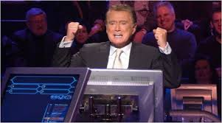
Hope you had fun!
If you want to partner with research more…
Look at dovetail for existing research
Join #research-insights, #adspromo-research-insights channels
Reach out to your designated partner Armando for Mx, Kelly for Cx
Utilize research review and support for self serve research and Mx Turbo Qual

